Slide 1

MOVIE RECOMMENDATION SYSTEM
-MINI PROJECT
Submitted by:
Manzar Shaikh(16CO50)
Mohd Zeeshan(16CO41)
Ayan Poonawala(16CO44)

Slide 2

RECOMMENDATION SYSTEM
Recommendationc system produce a ranked list of items on which a user might be interested,in the context of his current choice of an item.
Subclass of information filtering system that seek to predict the 'rating' or 'preference' that a user would give to system.
It is used in variety of applications like Movies,Books,Reseaarch articles etc.

Slide 3
TYPES OF RECOMMENDATION
RECOMMENDER SYSTEM
COLLABORATIVE FILTERING
CONTENT BASED APPROACH
HYBRID MODELS

Slide 4
MOVIE RECOMMENDATION SYSTEM
CONTENT BASED
The Recommendation system recommends other movies which are similar to the search movie.
It used a series of discrete characteristics of an item in order to recommend additional items with similar properties.
f(Movie) --> {Movies}

Slide 5
MOVIE RECOMMENDATION SYSTEM
COLLABORATIVE
The Recommendation system recommeds movies which are rated highly by the similar user.
It build a model from user’s past behavior (i.e. Movies purchased or searched by the user) as well as similar decisions made by other users.
f(Movie,User) --> {Movies}

Slide 6
DATASET USAGE
We have used Movielens Dataset by Kaggles
This dataset consist of :
120,000 Rating (1-5) from 617 User on 9000 Movies.
Each User has rated atleast 150 movies.
Each movies having Rating ,Image link,Details,Genre.

Slide 7
MOVIE RECOMMENDATION SYSTEM
COLLABORATIVE
Collaborative filtering is a method of making automatic predictions (filtering) about the interests of a user by collecting preferences or taste information from many users.
Makes use of the user data , ignoring content.
Almost every commercial recommenders use this approach
Such as : AMAZON,FACEBOOK,LINKEDIN

Slide 8
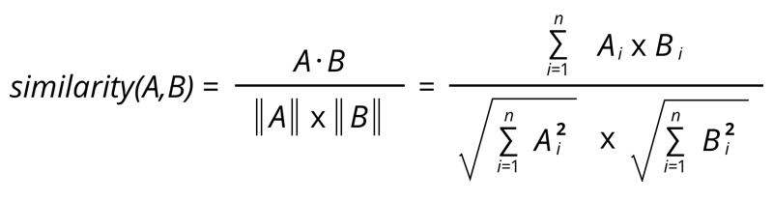
COLLABORATIVE APPROACH
COSINE SIMILARITY :
Cosine similarity measures the similarity between two vectors of an inner product space. It is measured by the cosine of the angle between two vectors and determines whether two vectors are pointing in roughly the same direction. It is often used to measure document similarity in text analysis.

Slide 9
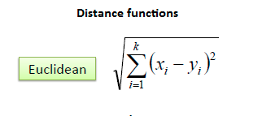
COLLABORATIVE APPROACH
KNN ALGORITHM :
K nearest neighbors is a simple algorithm that stores all available cases and classifies new cases based on a similarity measure (e.g., distance functions).
A case is classified by a majority vote of its neighbors, with the case being assigned to the class most common amongst its K nearest neighbors measured by a distance function. If K = 1, then the case is simply assigned to the class of its nearest neighbour.

Slide 10
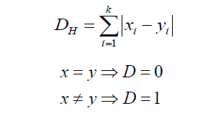
COLLABORATIVE APPROACH
It should also be noted that the distance measures are only valid for continuous variables. In the instance of categorical variables the Hamming distance must be used. It also brings up the issue of standardization of the numerical variables between 0 and 1 when there is a mixture of numerical and categorical variables in the dataset.

Slide 11

COLLABORATIVE APPROACH
EUCLIDEAN DISTANCE :
It is just a distance measure between a pair of samples p and q in an n-dimensional feature space:

Slide 12
GRAPHICAL USER INTERFACE
CONTENT IS IMPORTANT,BUT CONTENT ALONE WILL NOT MAKE YOUR SITE WORK.
GOOD DESIGN IS:
UNDERSTANDABLE
INTERESTING
EASY TO USE
UNIFORM IN LOOK

Slide 13



GRAPHICAL USER INTERFACE
TECHNOLOGY
HTML5
CSS3
BOOTSTRAP3
JAVASCRIPT

Slide 14
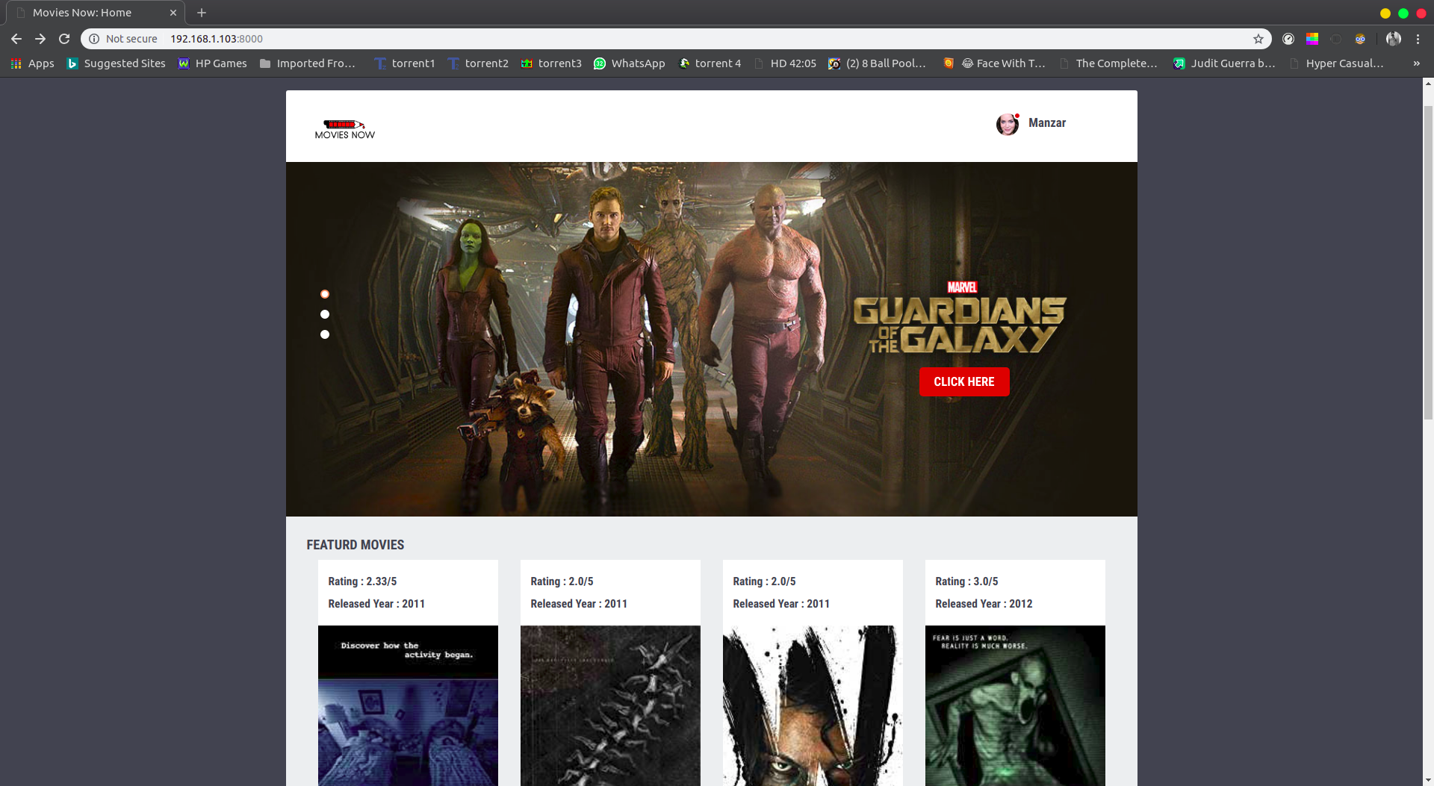
GRAPHICAL USER INTERFACE
UI OUTPUT

Slide 15
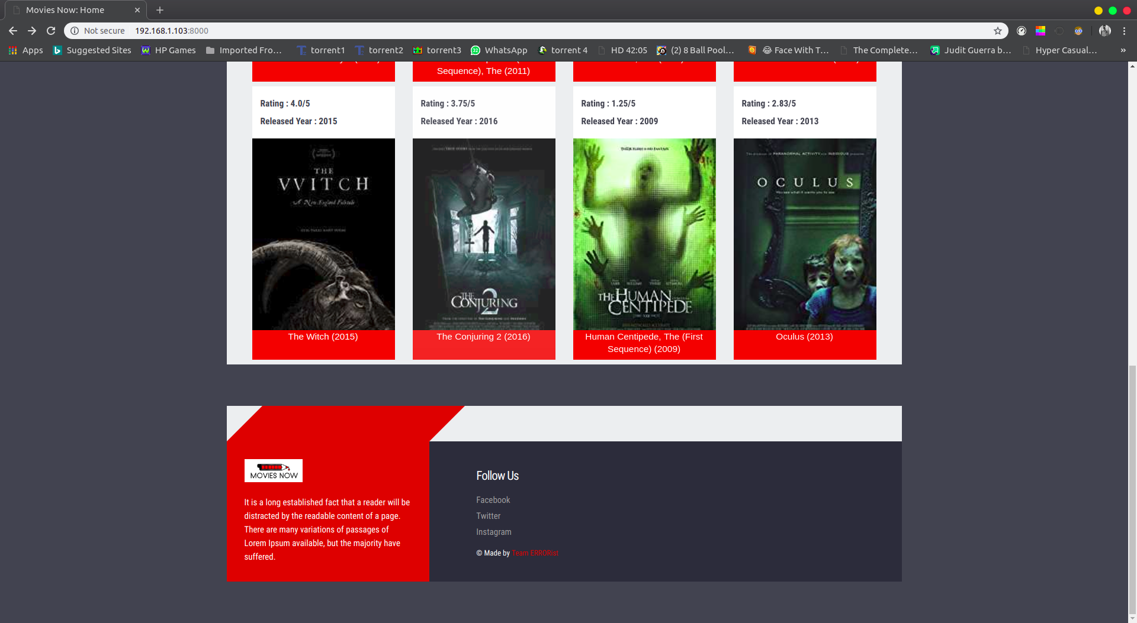
GRAPHICAL USER INTERFACE

Slide 16
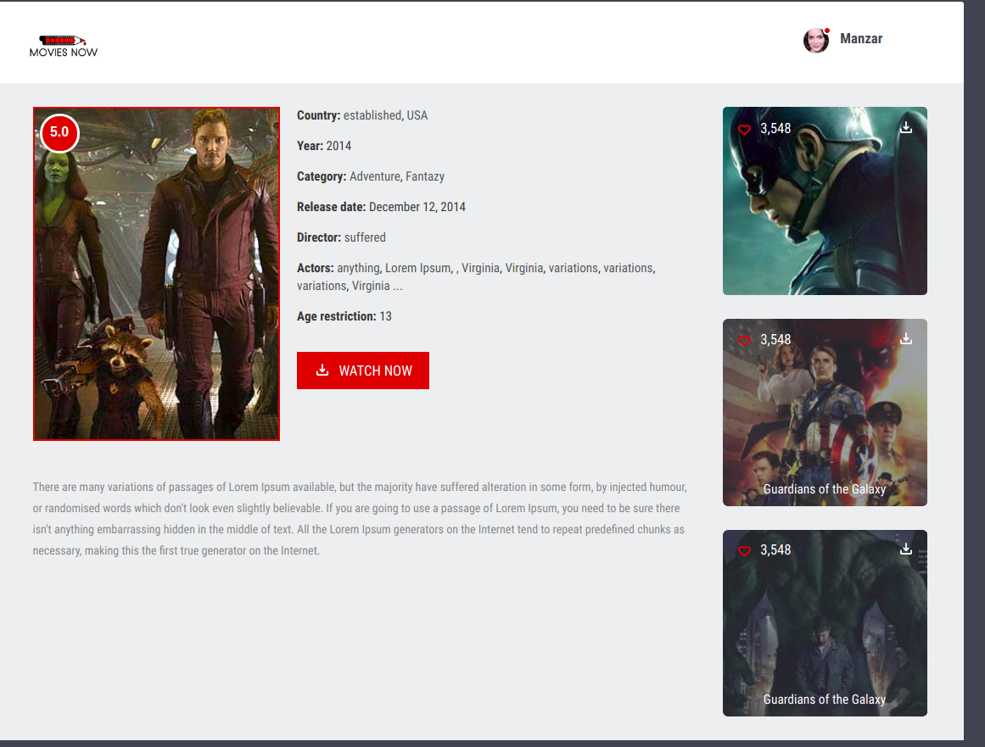
GRAPHICAL USER INTERFACE

Slide 17




SERVER-SIDE TECHNOLOGY
TECHNOLOGY
PYTHON3
DJANGO 2.0.7
MYSQL
APACHE

Slide 18
Thank You
Thank You

